Slide 1
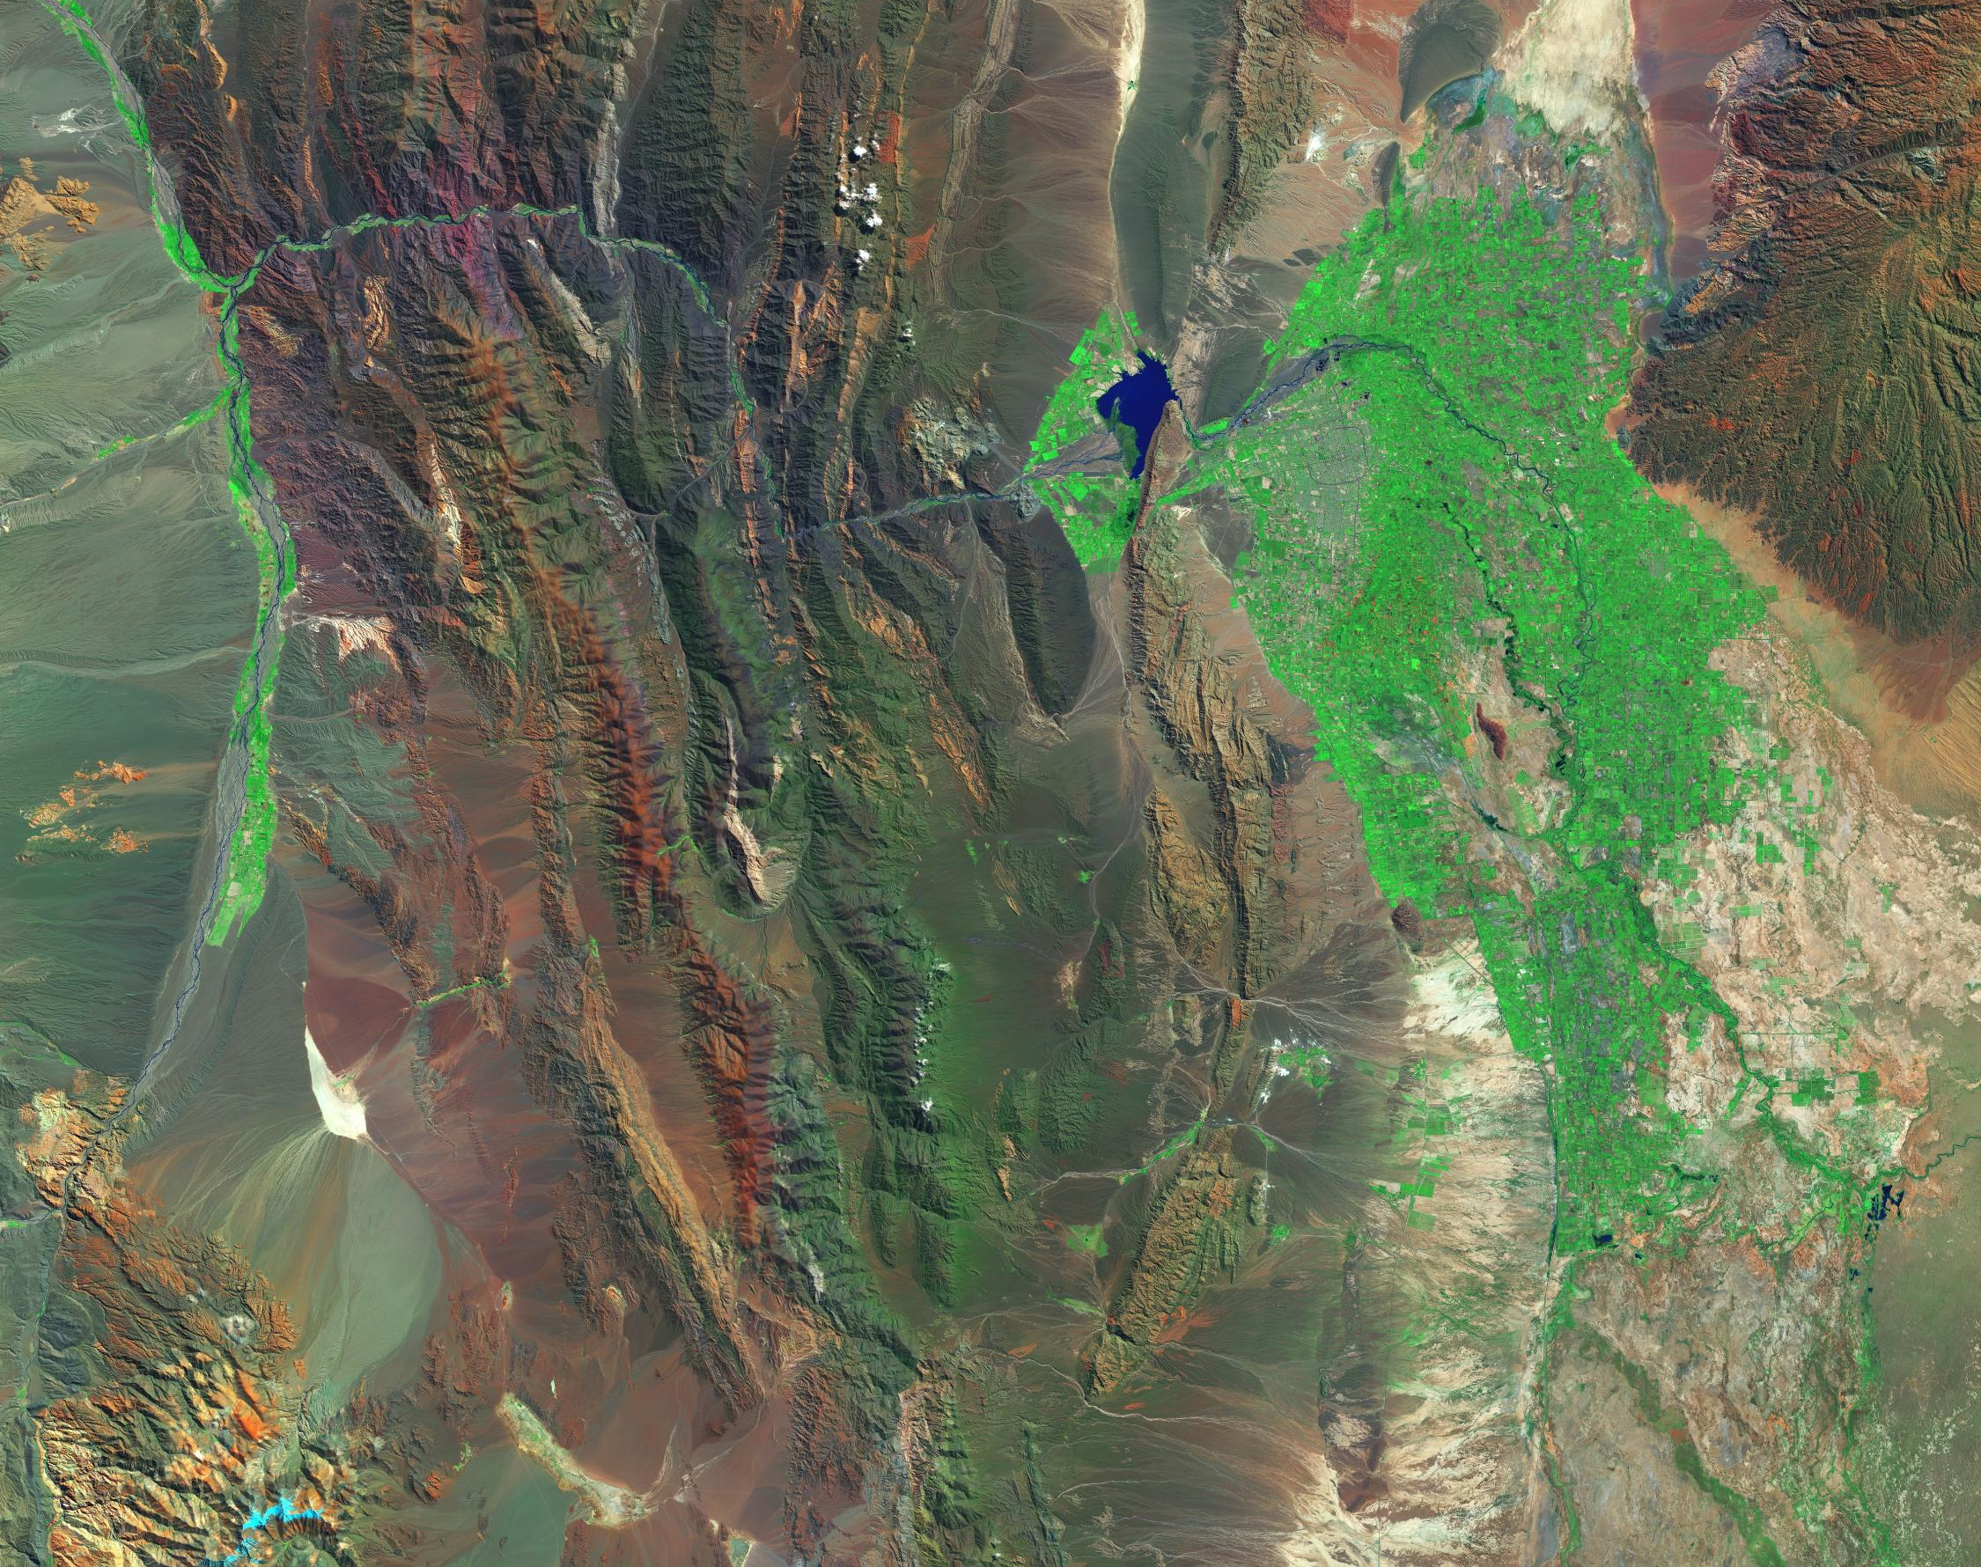
Land Use and Land Cover Classification in Angola, Africa
Classifying freshwater, cultivated areas, built-up areas, and open forests
Presenter : Ezequiel Mussambe
Date: 12/06/2024

Slide 2
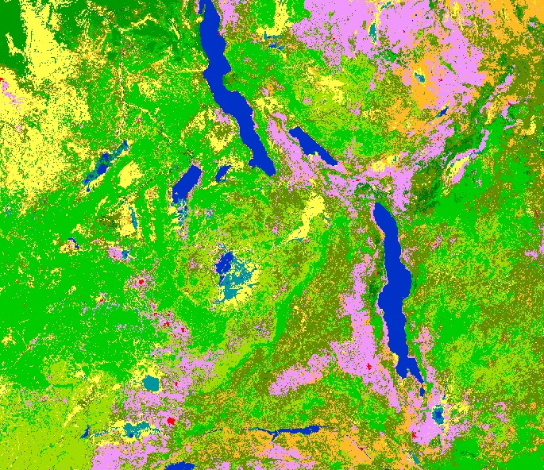

What is LULC? Involves categorizing the earth’s surface into various classes(e.g, water body,urban land, crop land, etc…).

Slide 3
Introduction
Addressing Environmental Challenges, Land Use and Land cover maps are essential tools for environmental monitoring, urban planning, and agricultural management and effective management of natural resources.
For spatial distribution of different types of land cover, such as forest, agriculture, urban area , and water body.
Motivation
Accurate LULC classification help assessing resource management, policy-making, and understanding environmental changes over time.
Objective
The project aims to improve the classification of land use and land cover (LULC) using classic and modern ML models based on spectral band values extracted from satellite imagery.

Slide 4
Project Target Audience
Farmers
Environmentalists
Private/Governmental Agencies,

Slide 5
Data Source
Satellite Imagery
Provider : European Union/ESA/Copernicus,
More details are provided in the usage of the dataset : https://developers.google.com/earth-engine/datasets/catalog/COPERNICUS_S2_HARMONIZED#description
Land Use and Land Cover dataset with Label
Provider: Copernicus
More details are provided in the usage of the dataset : https://developers.google.com/earth-engine/datasets/catalog/COPERNICUS_Landcover_100m_Proba-V-C3_Global#bands

Slide 6
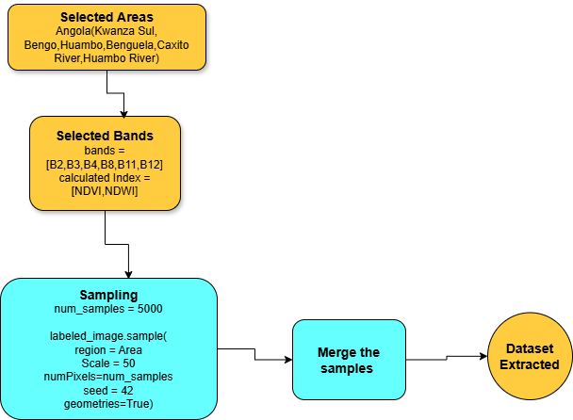
Data Processing using Earth Engine

Slide 7
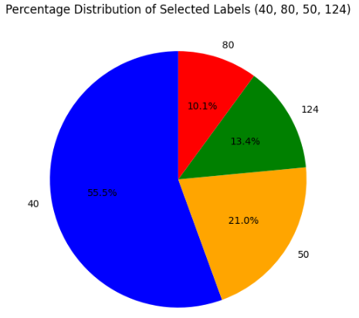
Dataset
Original Data Sample size ~ 9k
Training Samples ~ 7k
Test Samples ~ 2k
Attributes: Spectral band values - Numerical
Label : Class types (40,50,80,124) – Categorical
Label levels: 4
40-Cultivated
50-Urban/Built up
80-Fresh Water body
124-Open forest.
Area of Interest : Angola, Africa

Slide 8
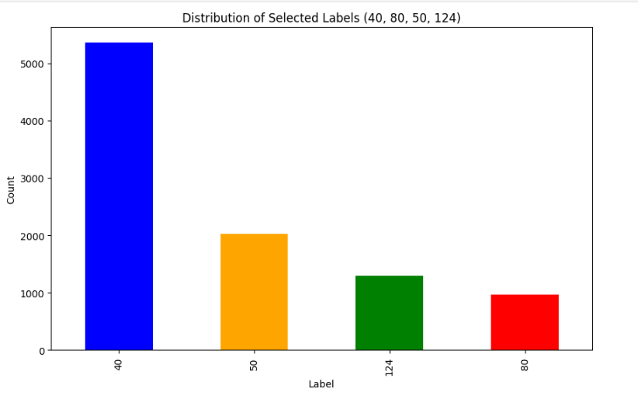
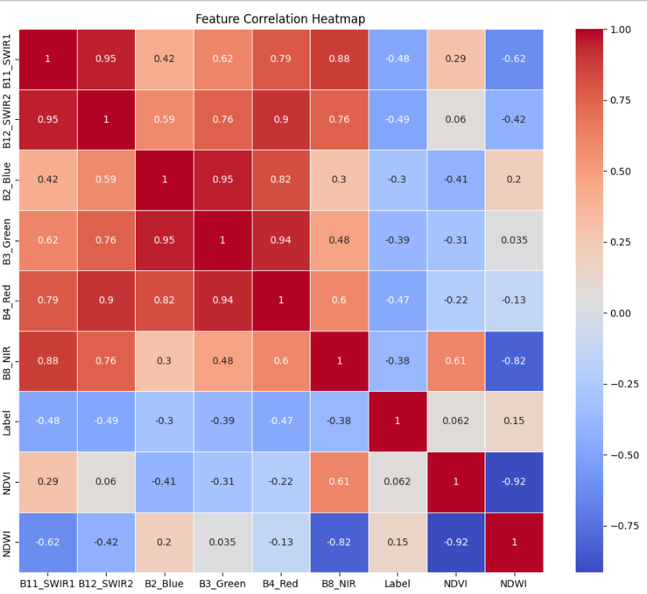
Exploratory Data Analysis

Slide 9
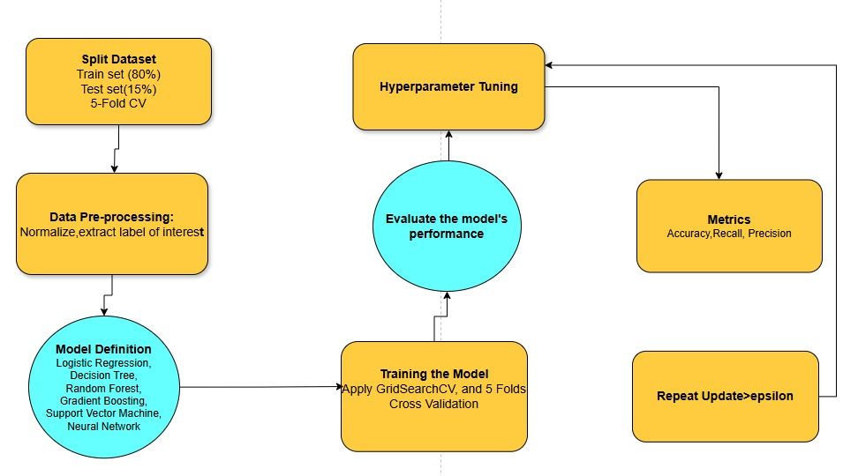
Modeling Approach

Slide 10
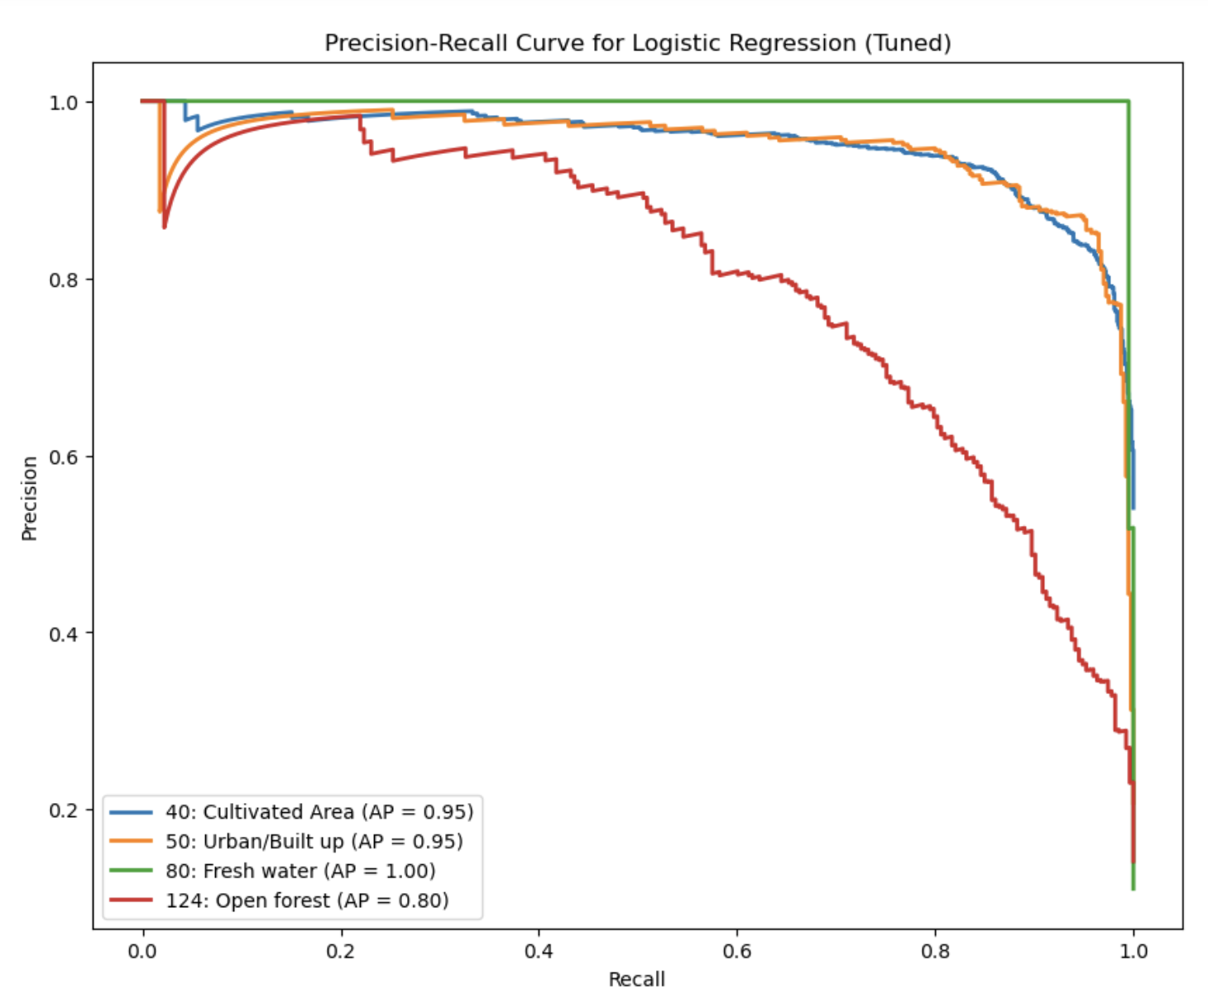
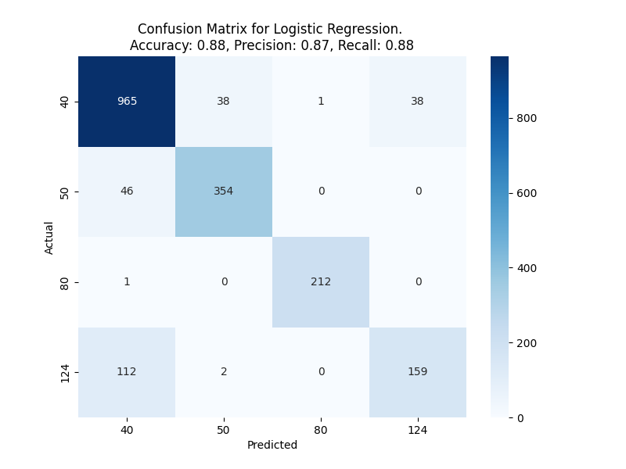
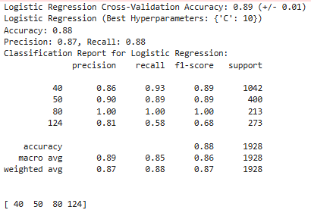
Logistics Regression Model -Result

Slide 11
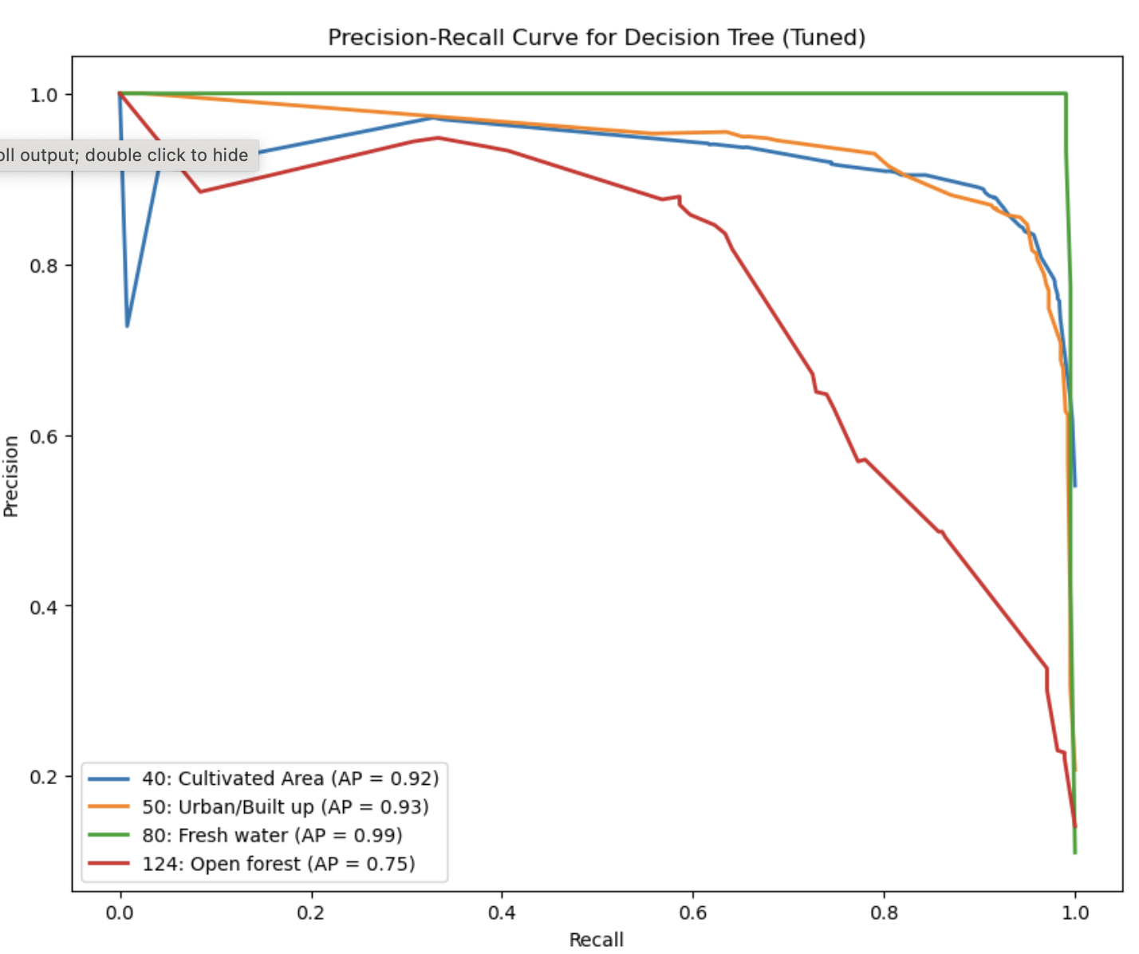

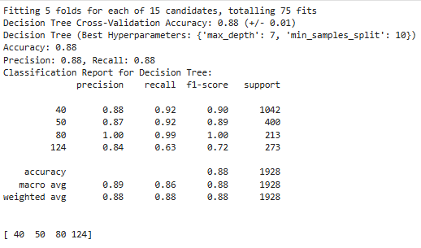
Decision Tree Model -Result

Slide 12
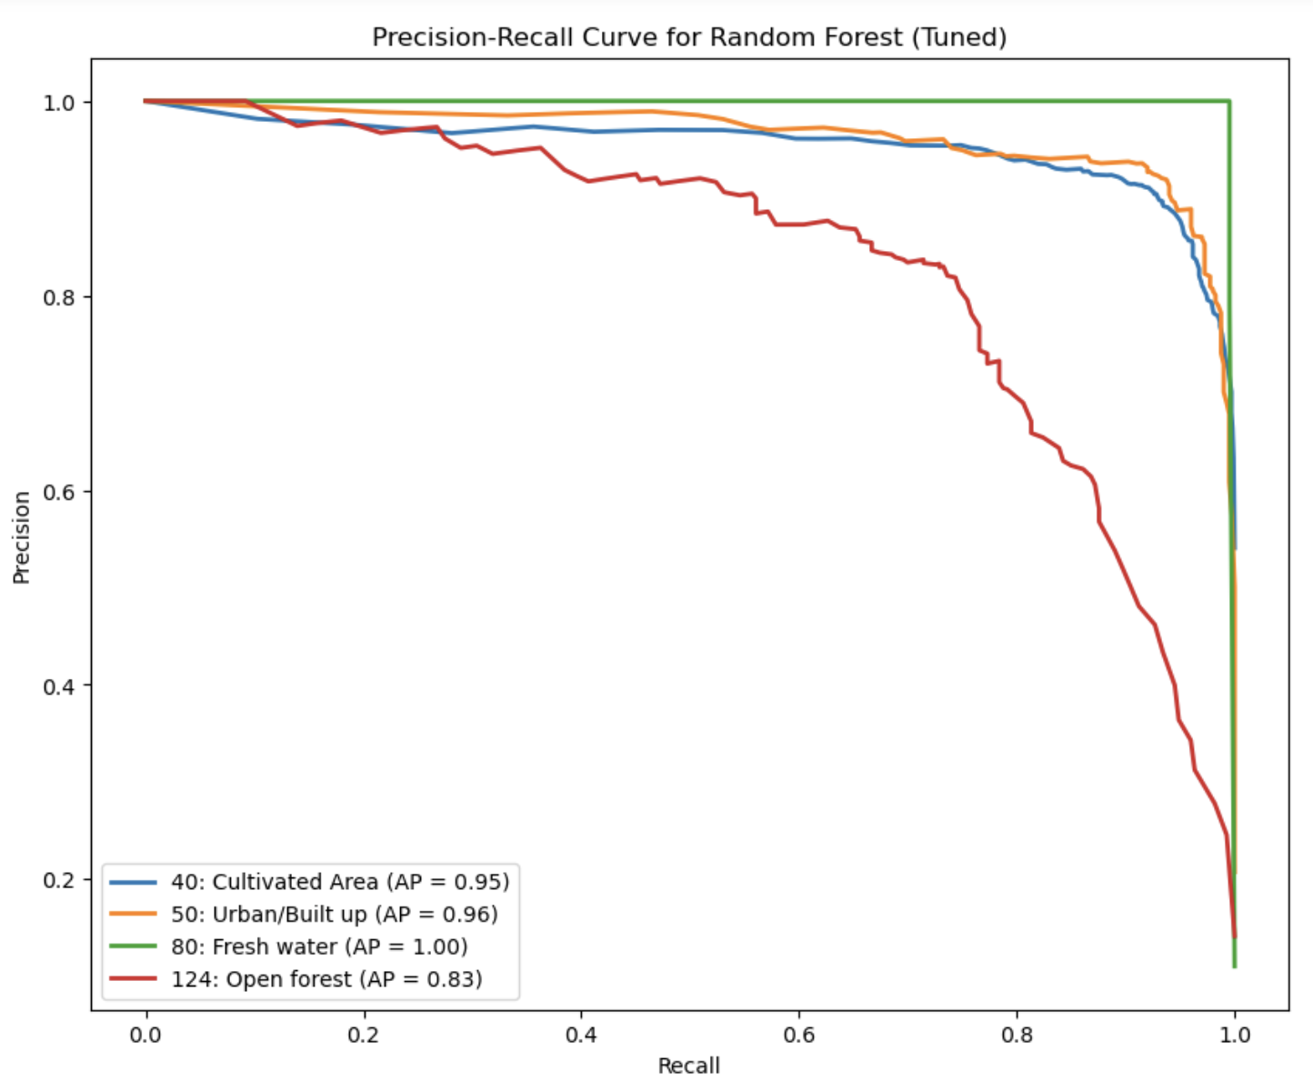

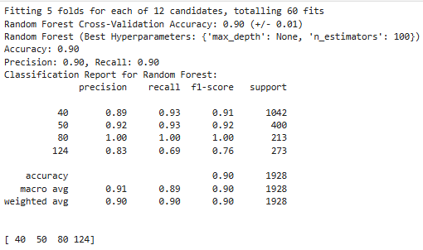
Random Forest Model -Result

Slide 13
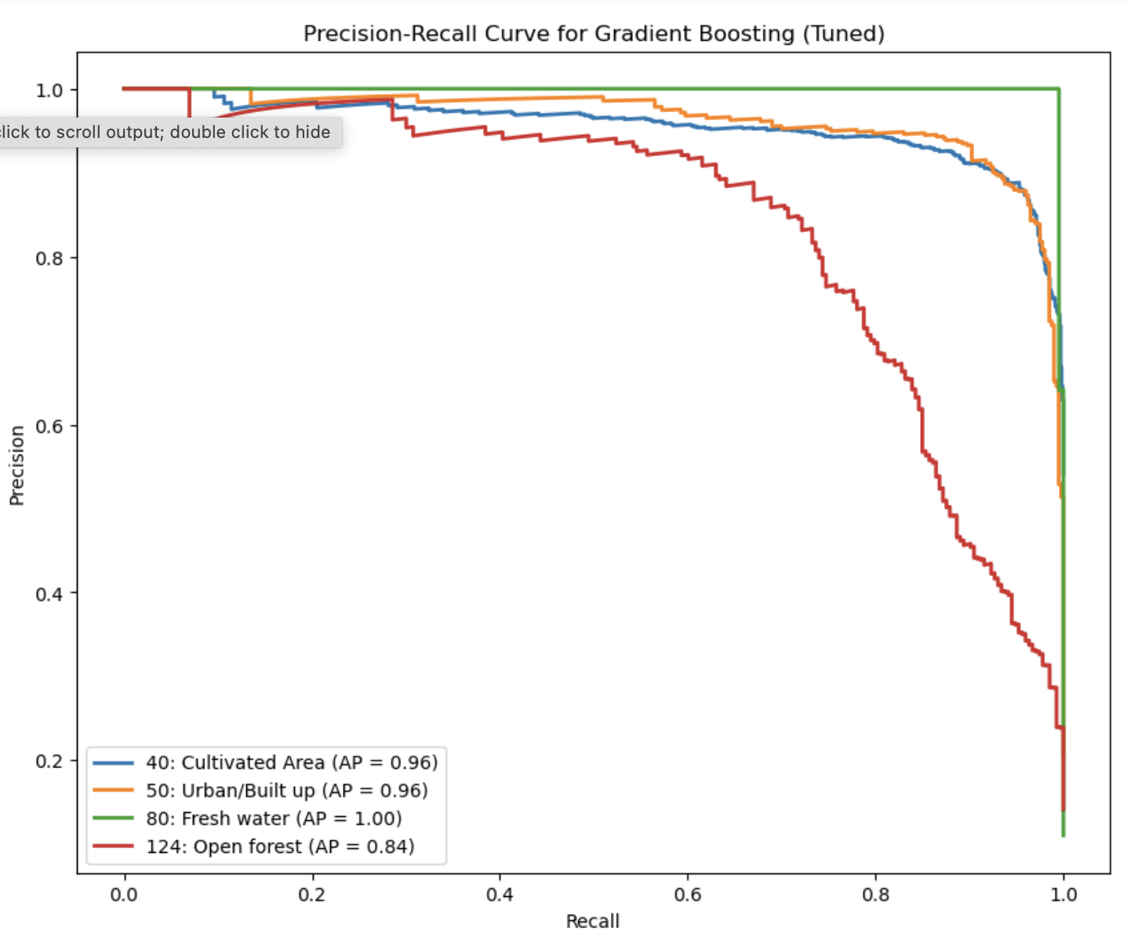

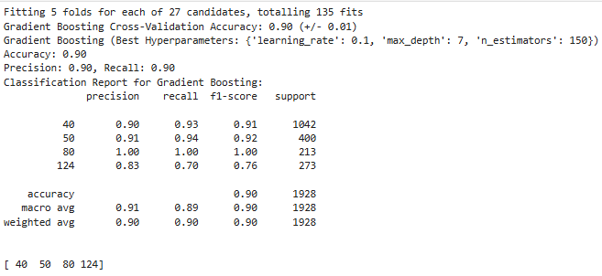
Gradient Boosting Model -Result

Slide 14
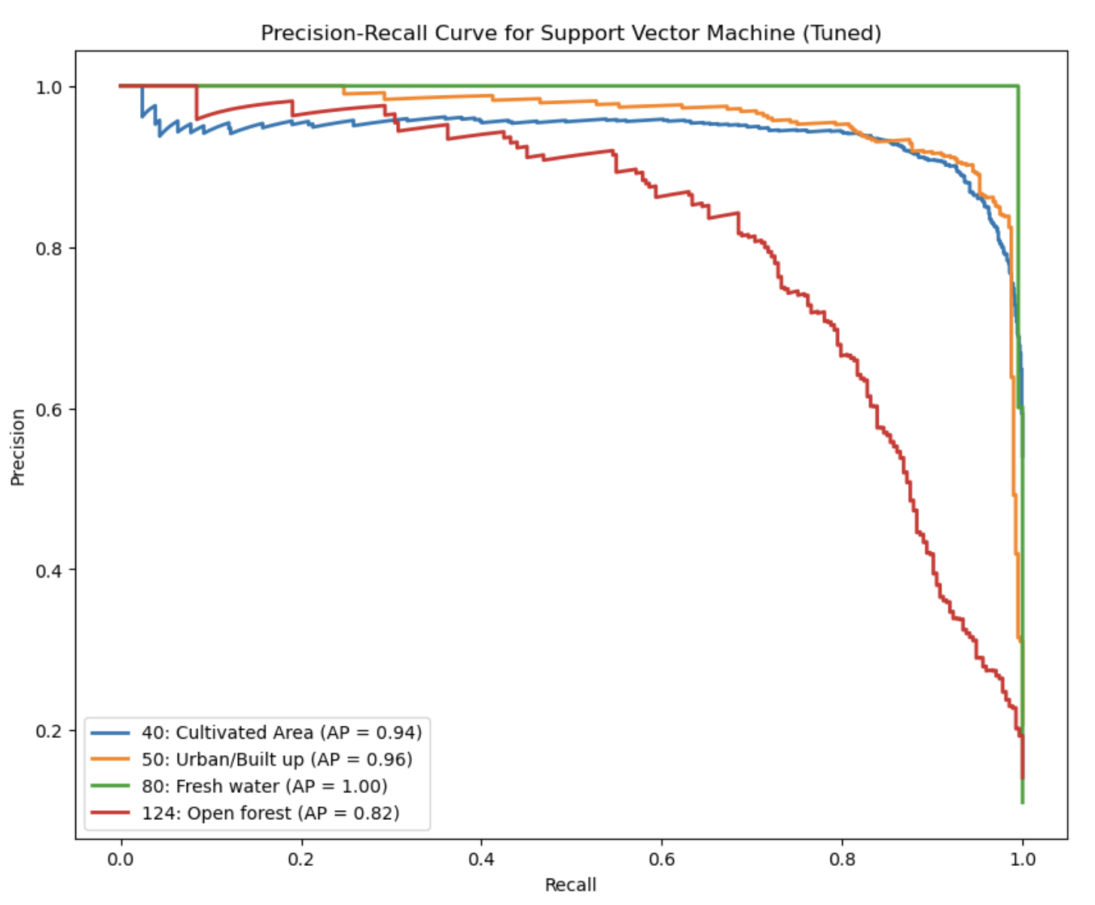

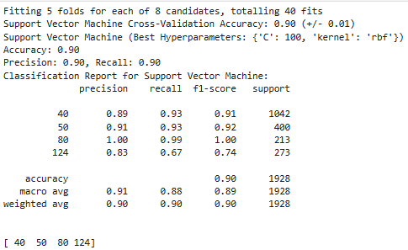
Support Vector Machine Model
-Result

Slide 15
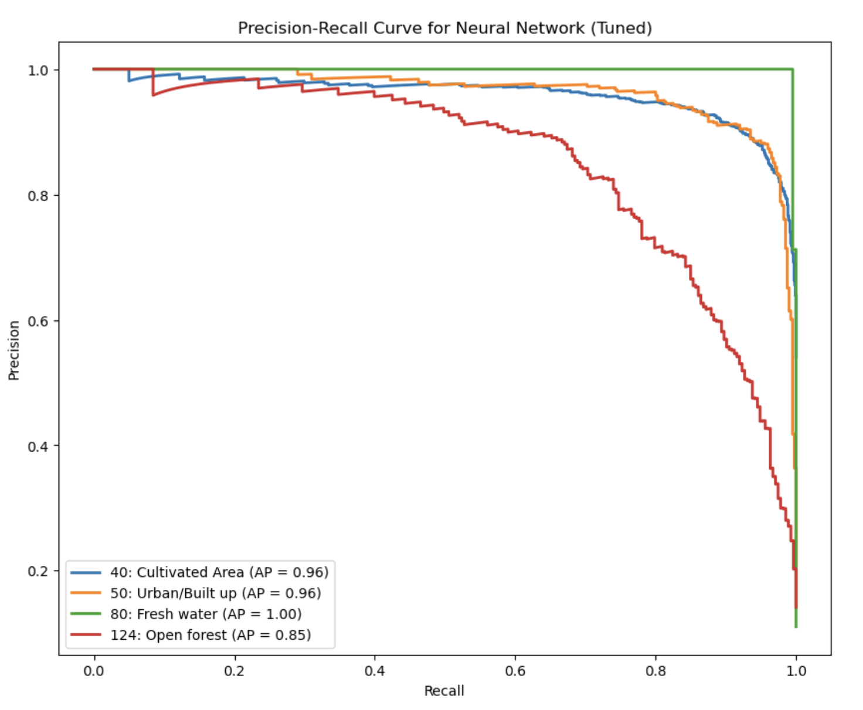


Neural Network Model -Result

Slide 16
Results
Model | Accuracy | Precision | Recall
Logistic Regression | 88% | 88% | 88%
Decision Tree | 88% | 88% | 88%
Random Forest | 90% | 90% | 90%
Gradient Boosting | 90% | 90% | 90%
SVM | 90% | 90% | 90%
Neural Network | 90% | 90% | 90%

Slide 17
Future Improvements/Suggestions
Considering collecting more data samples to better overcoming the issue of imbalance dataset.
Incorporate Visual data: tile images
Incorporate the spatial correlation and coordinate reference
Consider implement Convolution Neural Network by converting the pixel-based dataset into tile image based.

Slide 18
QUESTIONS?
THANK YOU !

